Slide 1

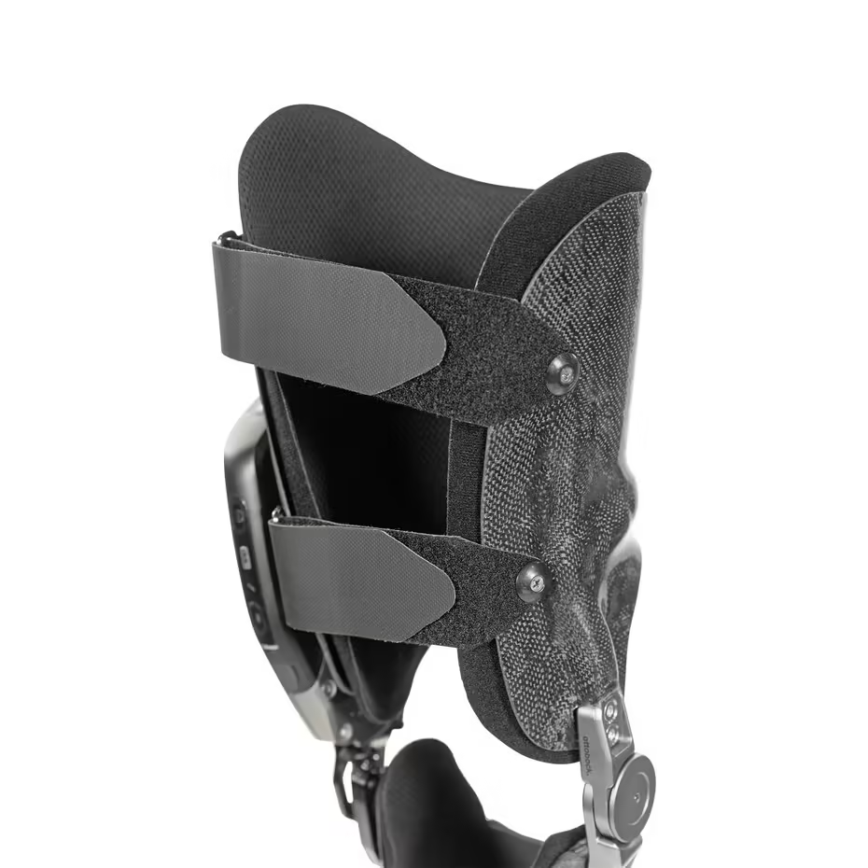
SMART ORTHOPEDIC
KNEE BRACE
INTRODUCTION TO NN, CNN and GNN(24AIM113)
ANALOG SYSTEM DESIGN(24AIM114)
Harithra S. – CB.AI.U4AIM24013
Harshath A. – CB.AI.U4AIM24015
N S Tharika. – CB.AI.U4AIM24027
RA Thanushika Sri. – CB.AI.U4AIM24034
GROUP 12

Slide 2
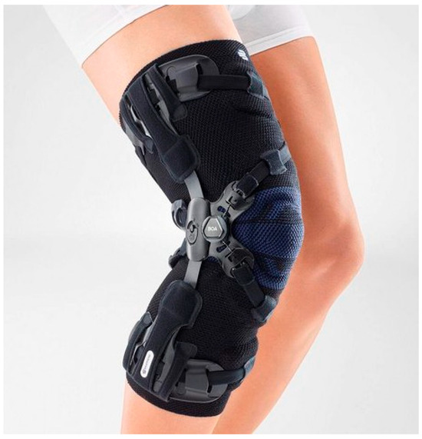
INTRODUCTION
Orthopedic rehabilitation is essential for recovery from musculoskeletal injuries, but unsupervised exercises often lead to improper movements, reinjury, or delayed progress.
Traditional physiotherapy relies heavily on clinic visits and generalized instructions, which can be costly and inaccessible for many.
This project introduces a smart orthopedic brace to address these challenges by integrating motion tracking sensors and real-time analysis using MLP.
The device aims to empower patients with accurate, personalized feedback, ensuring safe and effective rehabilitation at home.

Slide 3
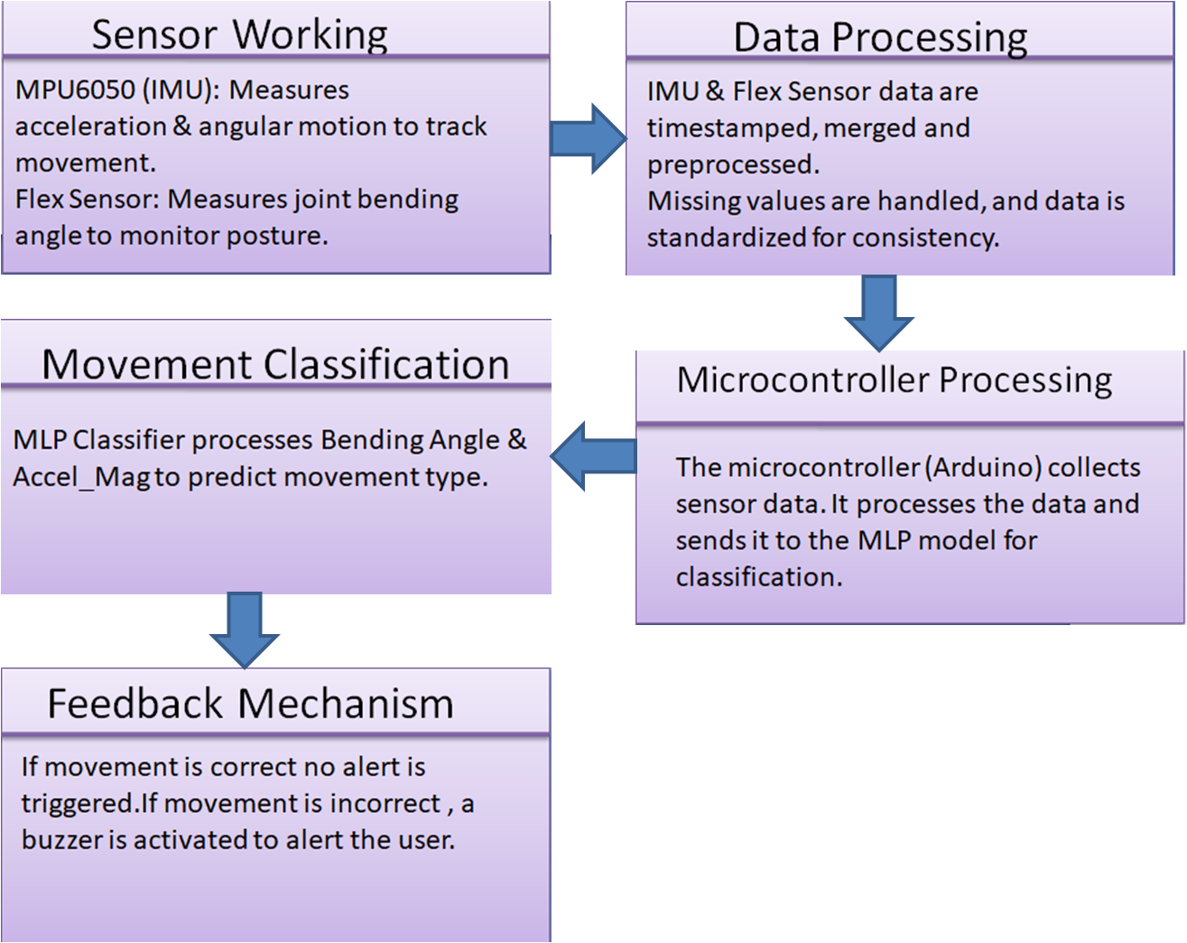
WORKING PRINCIPLE

Slide 4
UPDATES
ANALOG
NEURAL NETWORKS
REVIEW 1
1.Hardware components(flex sensor , MPU6050 ) were gathered
2.Tinkercad Simulation were done before working in real time
REVIEW 2
1.Real Time Readings were taken
2.Sensor integration circuit is made.
REVIEW 1
1.Data collection and pre 2.Processing steps were done.
REVIEW 2
1.Built a model using MLP and evaluated the metrics.Integrate the model with hardware

Slide 5
HARDWARE IMPLEMENTATION
COMPONENTS | SPECIFICATION
FLEX SENSOR | Resistance Range: Typically 10kΩ to 40kΩ (varies with bending). Bend Sensitivity: Resistance increases with bending.
IMU (Inertial Measurement Unit) | Sensors: Typically includes accelerometer, gyroscope, and sometimes magnetometer. Output: 3-axis motion data (acceleration, angular velocity, and orientation). Communication: I2C
MICROCONTROLLER | Operating Voltage: 5V. Digital I/O Pins: 14. Analog Input Pins: 6.
ACTIVE BUZZER | Operating Voltage 3V – 5V DC Current Consumption 10 – 30mA Sound Output (dB) 80 – 95 dB

Slide 6
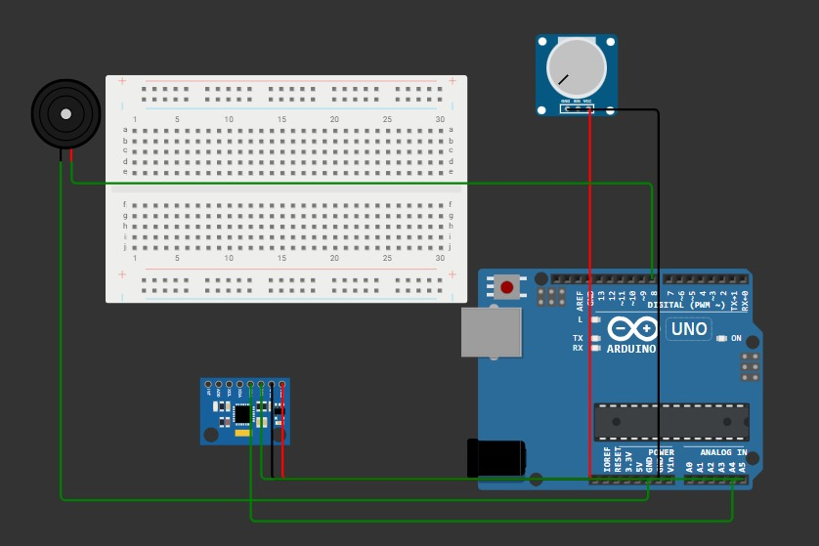
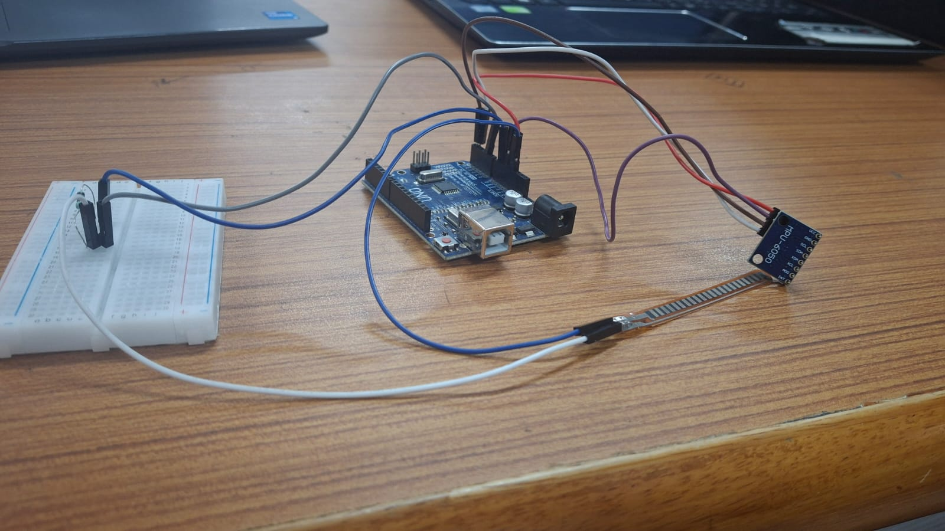
CIRCUIT CONNECTIONS

Slide 7
MLP NETWORK ARCHITECTURE
Input Layer
Takes in sensor readings (e.g., Bending_Angle, Accel_Mag)
Hidden Layers
Process sensor data and extract movement patterns.
First Hidden Layer → 64 Neurons
(Extracts patterns from Bending_Angle & Accel_Mag)
Second Hidden Layer → 32 Neurons
(Further refines patterns detected by the first layer)
Output Layer
Predicts the movement type.

Slide 8
MLP NETWORK ARCHITECTURE
Activation Function: 'ReLU'
Rectified Linear Unit is applied to the hidden layers: f(x)=max⁡(0,x)
(Keeps positive values the same, making learning efficient.)
Optimizer: Adam (Adaptive Moment Estimation)
It is an advanced optimization algorithm used to update model weights efficiently and helps the model learn faster and accurately.
Learning Rate=0.00005
Smaller values leads to slower learning, but with better accuracy.

Slide 9
REFINED CLASSIFICATION CRITERIA
Neutral:
Bending Angle: ≈ 0°
Accel_Mag: (0.50 to 0.70)
Slight Bend:
Bending Angle: 0° < Angle ≤ 30°
Accel_Mag: (0.40 to 0.85)
Moderate Bend:
Bending Angle: 30° < Angle ≤ 60°
Accel_Mag: (0.25 to 1.0)
Critical Bend (Warning):
Bending Angle: > 55° (Slightly lowered to increase classification cases)
Accel_Mag: < 0.25 or > 0.90

Slide 10
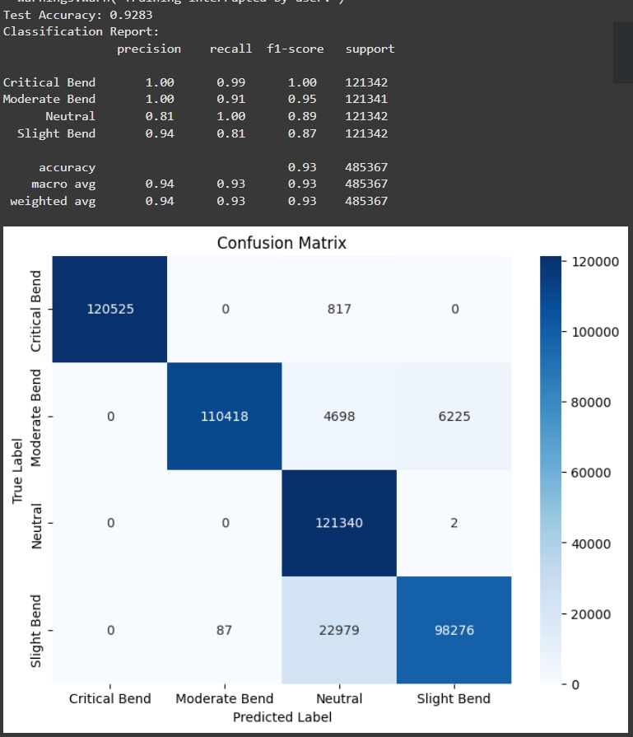
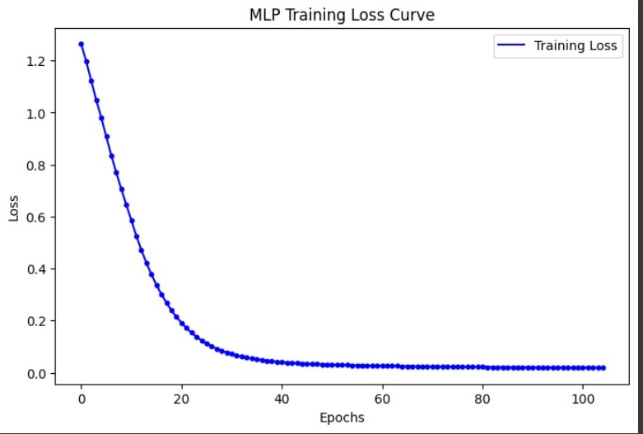
CONFUSION MATRIX
LEARNING CURVE

Slide 11
REFERENCES:
[1]https://www.researchgate.net/figure/Smart-left-knee-brace-for-dynamic-knee-laxity-measurements-1-Femoral-unit-IMU_fig1_362495682
[2]https://www.semanticscholar.org/paper/Toward-Personalized-Orthopedic-Care%3A-Validation-of-McPherson-McDaid/0363b340b56bebddd7700e2d4efb6fca5e154c76
[3]https://www.researchgate.net/publication/241274431_A_magnetorheological_fluid-based_controllable_active_knee_brace_-_art_no_65270O
[4]https://pubmed.ncbi.nlm.nih.gov/36560329/
[5]https://dr.ntu.edu.sg/handle/10356/74662
[6]https://pubmed.ncbi.nlm.nih.gov/36149519/
Thank you!

